Slide 1
Python 101 Auto Grader
Design of the program

Slide 2
Python 101 Auto Grader
Design of the program
List of Students (where each item in the list reflects a student)
List of Assignments (where each item in the list reflects an assignment (name, due_date and max_points dictionary)
Dictionary of Emails (student_email is the key; And parents data is another nested dictionary)

Slide 3
Representing a Student Data
(dictionary containing a dictionary)
KEY | VALUE
Quiz1 | None
Quiz2 | None
Quiz3 | 10.0
lab1 | 10.0
 | 10.0
 | …
 | ..
 | …
 | None
Final_project | None
KEY | VALUE
last_name | ln1
first_name | fn1
email | fn1.ln1@learnandhelp.com
scores

Slide 4
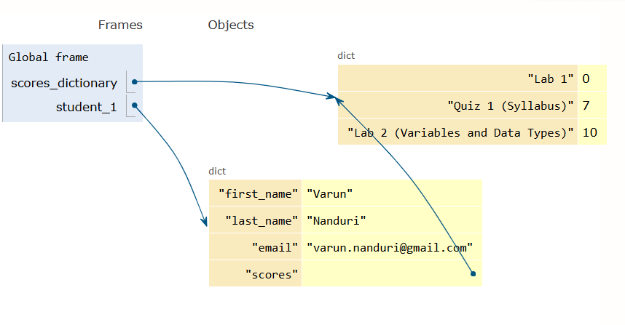
Representing a Student Data
(dictionary containing a dictionary)

Slide 5
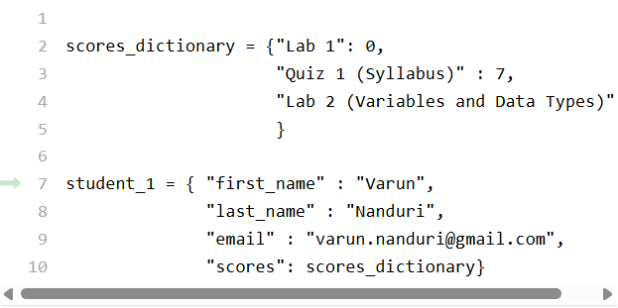
Representing a Student Data
(dictionary containing a dictionary)

Slide 6
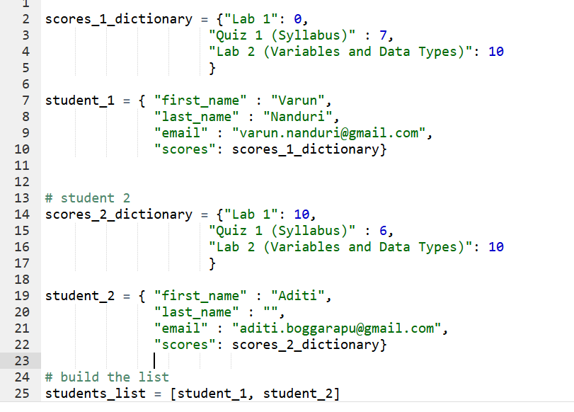
Representing two Students
(dictionary containing a dictionary)

Slide 7
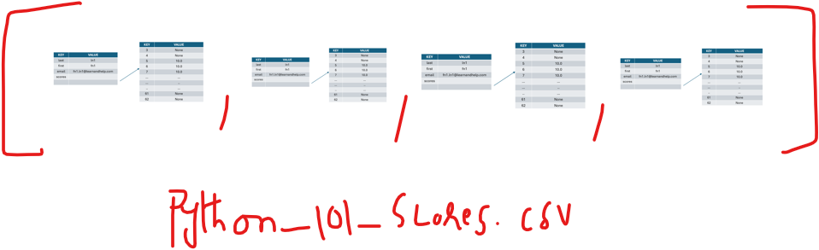
Representing all Students
(list of student dictionaries)
student_data_with_scores (suggested variable name)
Python 101 Auto Grader
Design of the program

Slide 8
How to represent the assignments data?
While processing the scores, we can also populate the assignments list.
assignments_table = {“name”: val,
“max_points”: val,
“due_date”: val}
assignments_list = [assignments_table_1, assignments_table_2, and so on]
KEY | VALUE
name | Lab 1
max_points | 12
due_date | 5/17/26

Slide 9
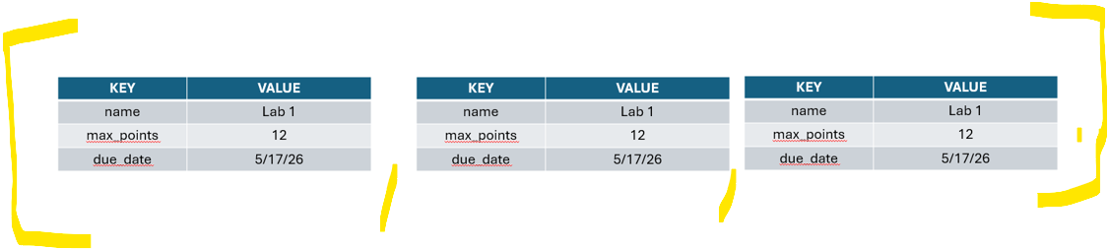
How to represent the assignments data?
While processing the scores, we can also populate the assignments list.
assignments_table = {“name”: val,
“max_points”: val,
“due_date”: val}
assignments_list = [assignments_table_1, assignments_table_2, and so on]
KEY | VALUE
name | Lab 1
max_points | 12
due_date | 5/17/26

Slide 10
How to represent email data?
How to load “python_101_emails.csv”?
Last Name
First Name
Email
Parent 1 Last Name,
Parent1 First Name,
Parent1 Email
Parent2 Last Name,
Parent2 First Name,
Parent2 Email

Slide 11
Dictionary of dictionaries
Where
KEY = students email
And VALUE = is another dictionary
KEY | VALUE
p1_name | 'P2FNameln28fn28 P1LName ln28fn28
p1_email | P1_.fn28.ln28@learnandhelp.com
p2_name | 'P2FNameln28fn28 P2LName ln28fn28
p2_email | 'P2_.fn28.ln28@learnandhelp.com
KEY | VALUE
fn28.ln28@learnandhelp.com

Slide 12
This is the sample data from the data stucture
{'fn1.ln1@learnandhelp.com': {'p1_name': 'P2FNameln1fn1 P1LName ln1fn1', 'p1_email': 'P1_.fn1.ln1@learnandhelp.com', 'p2_name': 'P2FNameln1fn1 P2LName ln1fn1', 'p2_email': 'P2_.fn1.ln1@learnandhelp.com’},
'fn2.ln2@learnandhelp.com': {'p1_name': 'P2FNameln2fn2 P1LName ln2fn2', 'p1_email': 'P1_.fn2.ln2@learnandhelp.com', 'p2_name': 'P2FNameln2fn2 P2LName ln2fn2', 'p2_email': 'P2_.fn2.ln2@learnandhelp.com
We will have one dictionary.
Let us call it as “emails_lookup_table”.
If we have 30 students, this “email_lookup_table” will have 30 keys.

Slide 13
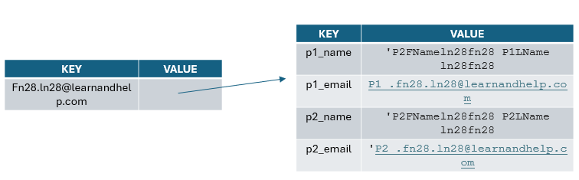
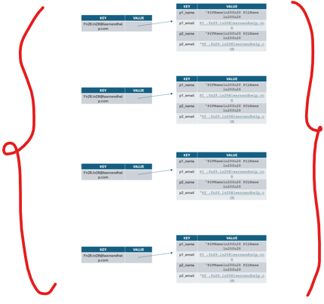
Visual Representaton of emails_lookup_table

Slide 14
Plan of action
[1] Build “emails_lookup_table”
Load python_101_emails.csv
Read it and process it to build “emails_lookup_table”
Print it to ensure that you are getting all the details transferred from CSV to this data structure
[2] Build “students_data_with_scores”
Load python_101_scores.csv
Read it and process it to build “students_data_with_scores” (Please ensure that the first three rows are given special treatment – headers/lables, dates, and max_permissible_points)
Print it to ensure that you are getting all the details transferred from CSV to this data structure

Slide 15
Plan of action (contd.)
[2] Process both the data structures at the same time to build “a student’s report” through a function.
[3] Process both the data structures at the same time to build “instructors” report (again through a function)
[4] Call all of the above functions to run the entire project.
Read python_101_emails.csv and process it
Read Python_101_scores.csv and process it
Create Student Reports
Create Instructor Report

